Slide 1
HASH ANALYTICS PROJECT PRESENTATION 2020 INTERNSHIP PROGRAM
BY
OLUWAFEMI AYOOLA

Slide 2
COMPANY X EMPLOYEE ATTRITION ANALYSIS
Employee attrition is simply loss of employee through natural course (i.e. not being sacked by employer). Attrition could cause great deficit in major key areas in a company consequently leading to low productivity of the company.
These following questions must be asked in order to investigate attrition in company X.
Why Employees are prone to leave the company?
What type of Employees are leaving?
Which employee is prone to leave the company next?
In order to address these questions, the dataset of the employees must be examined and machine learnint fitted into the dataset to predict the type of employees likely to leave next.

Slide 3
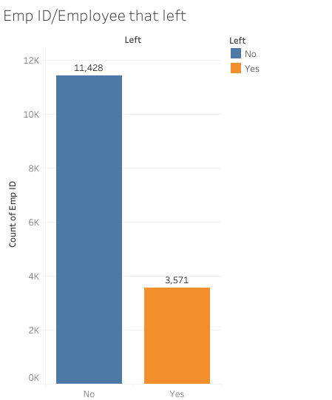
DATASET OF EMPLOYEES
The dataset of Company X contains two datasets;
Employees who have left (3571 samples and 10 attributes) and
Existing employeess (11,428 samples and 10 attributes)
(The dataset has a total of 14,999 samples, and 10 each attributes)

Slide 4
To study the reason for company X attrition, we would use these methods:
DATA ANALYSIS: This involves exploration and visualization of the datasets.(Using Tableau). This answer the first two questions; 'why employees are prone to leave the company?' and 'what type of employees are leaving?'.
MACHINE LEARNING PREDICTION MODEL: Building a machine learning model would aid answer the third question; 'which employee is prone to leave the company next?'.

Slide 5
DATA ANALYSIS(USING TABLEAU)
Analysis of the dataset using tableau helped see th bigger picture of the employees and also why there is attrition.
When analyzing this, it is important to analyze the dataset of the employee (both existing and ex-employee), to compare the two datasets based on the attributes provided using charts.
The relationship between different attributes could then be determined and related to the employee attrition rate.

Slide 6
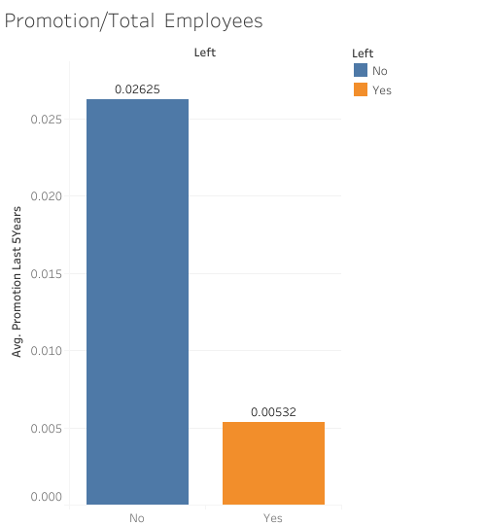
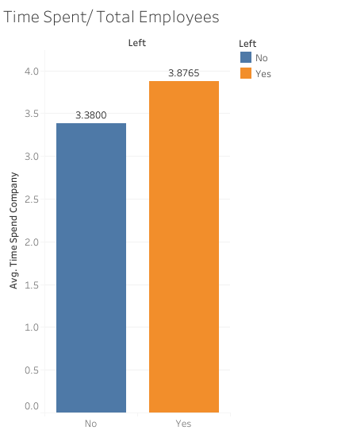
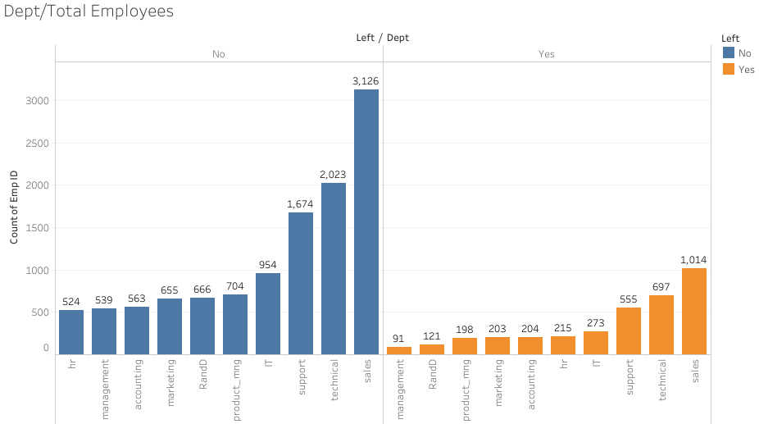
Below are some visualizations from Tableau explaining more about the attrition rate.

Slide 7
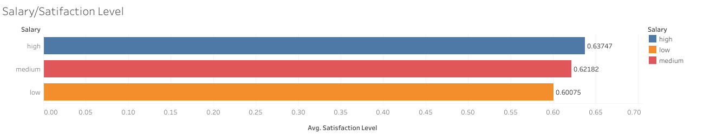
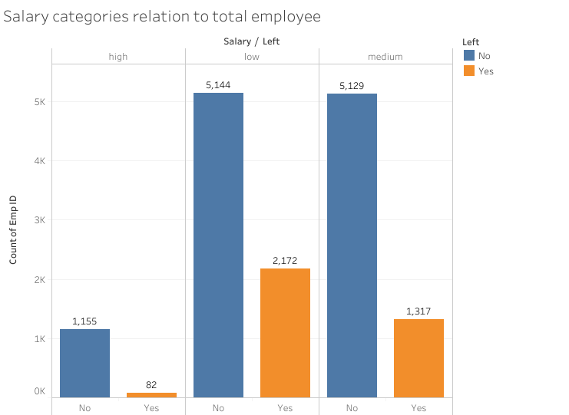
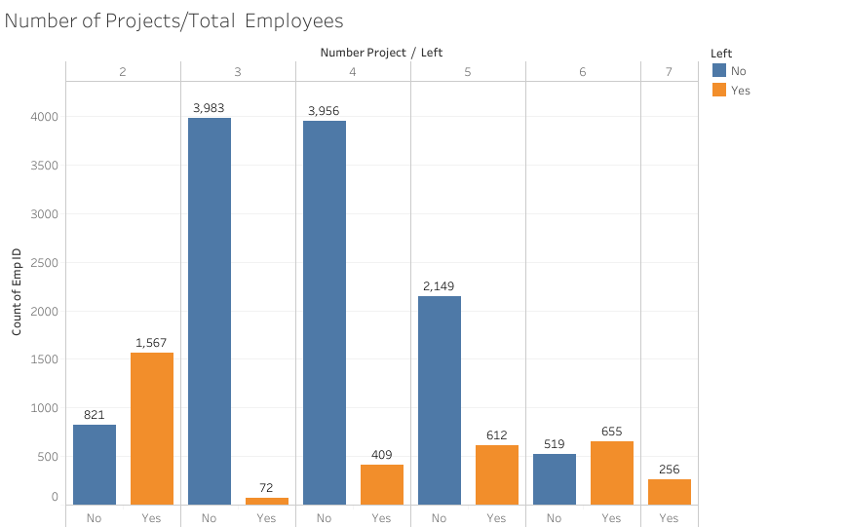

Slide 8
From the visualizations above, it is evident that;
Most employees that left the company have gotten:
no promotion in the last 5 years.
low and medium salary accompanied with,
more time spent working.
2 or less than projects and those also who have about 6 to 7 due to work overload.
more employees are from the sales department which also has high attrition rate because they are more involved in the frontline of business.
This answers the first two questions; 'why employees are prone to leave the company?' and 'what type of employees are leaving?'

Slide 9
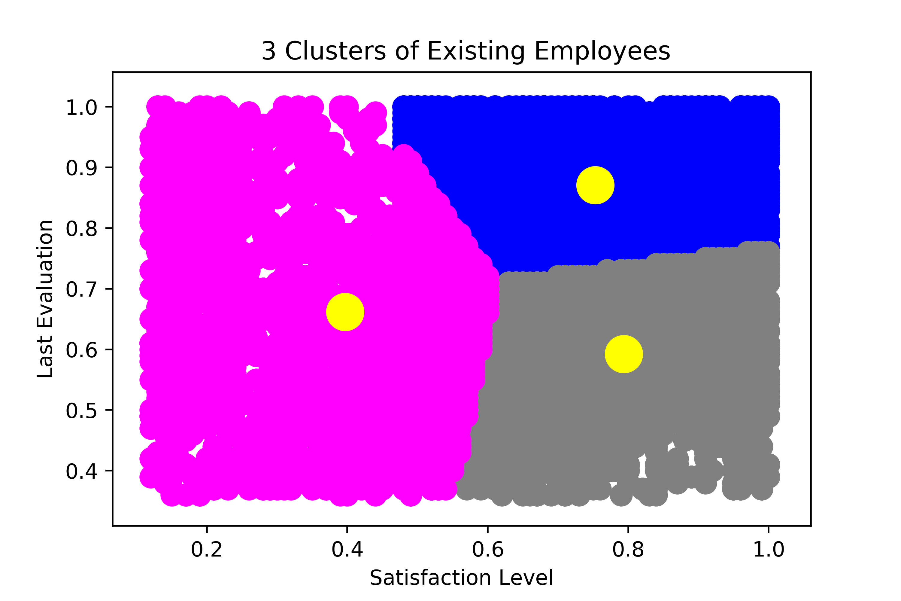
MACHINE LEARNING PREDICTION MODEL (USING PYTHON)
Using cluster analysis on python, we could group the employees who left the company into 3:
High Satisfaction level and High Evaluation(Shaded blue in the graph): These employees would'nt leave, they love the job.
High Satisfaction and less Evaluation(Shaded grey in the graph): They have low probability of staying.
Low Satisfaction and moderate Evaluation (Shaded magenta in the graph): These ones might not stay afterall.

Slide 10
MACHINE LEARNING PREDICTION MODEL (USING PYTHON)
Cluster analysis has told us about the categories of people who left the company, now we want to find out those of the employees that are prone to still leave. To do this we would prepare our dataset and fit into a machine learning model.
Data Pre-Processing: In order to get a dataset ready for machine learning model we must clean the data.
the employee status reperesented with yes or no(yes=still contracted while no=left) was changed to binary form which machine learning recognises.
some columns like 'dept','salary' were dropped from dataset.
splitted the dataset into training (70%) and testing(30%) sets.

Slide 11
MACHINE LEARNING PREDICTION MODEL (USING PYTHON)
Using the DecisionTreeClassifier, i was able to train the data and the machine learning model was ready for use.
I ran predictions using the model built and the accuracy score which came back with an 100% accuracy.
I then exported the predicted values using pandas library to create a new dataframe with 2 attributes('Emp ID','Emp Stay/Leave': this serving as the machine learning model prediction results).

Slide 12
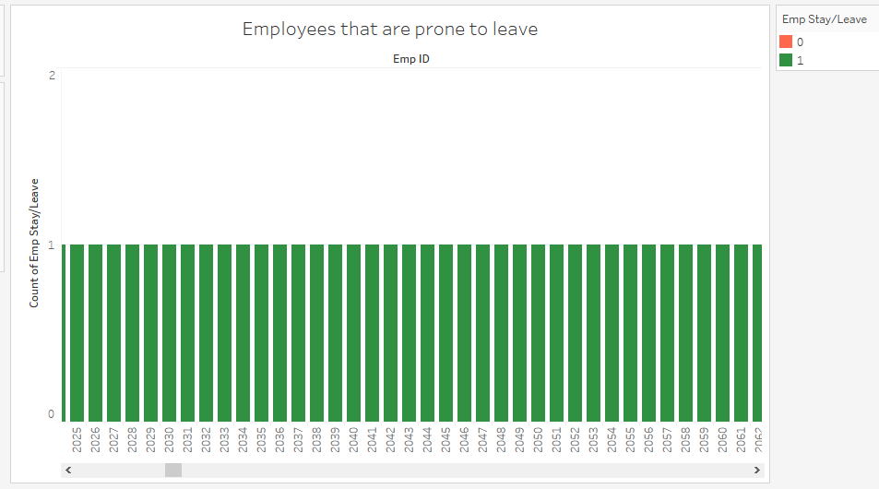
The model predicted 3465 employees are prone to leave the company, this answers our third question: “which employee is prone to leave the company next?”.
I then visualized this results using tableau.

